Slide 1


Relationships and Sex Education (RSE)
Parent information
Cambridge Park Academy is committed to safeguarding and promoting
the welfare of children and young people and upholding inclusive values.

Slide 2
What is RSE?
The Department for Education is introducing compulsory RSE from September 2021 for all schools.
The aim of RSE is to give young people the information they need to help them develop healthy, nurturing relationships of all kinds, not just intimate relationships. It should enable them to know what a healthy relationship looks like and what makes a good friend, a good colleague and a successful marriage or other type of committed relationship.
It should teach what is acceptable and unacceptable behaviours in relationships.
Pupils will understand the positive effects that good relationships have on their mental wellbeing, identify when relationships are not right and understand how such situations can be managed.
The Department for Education recommends that all schools have a sex education programme tailored to the age and the physical and emotional maturity of the pupils. It should ensure that both boys and girls are prepared for the changes that adolescence brings and – drawing on knowledge of the human life cycle set out in the national curriculum for science – how a baby is conceived and born.

Slide 3
What does the guidance from DFE mean?
Relationship Education will be compulsory in all schools with primary schools being urged to include sex elements where appropriate
Health Education will be compulsory in all schools
All schools must have a written policy for RSE
‘All schools may teach about faith perspectives’ and ‘balanced debate may take place about issues that are seen as contentious’. Religious leaders from different faith backgrounds have been involved in developing the RSE curriculum
‘At the point at which schools consider it appropriate to teach their pupils about LGBT, they should ensure it is fully integrated’.
‘Schools should ensure that the needs of all pupils are appropriately met’ – must comply with the Equality Act 2010 and protect individuals from discrimination. There are 9 protected characteristics (aspects of a person’s identity)
Puberty including menstruation should be ‘addressed before onset’.

Slide 4
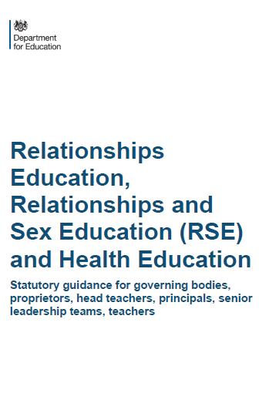

Compulsory status of RSE and Health Education
What must schools teach?
In 2017 the government passed an amendment to the Children and Social Work Bill to make RSE and Health Education statutory from Sept 2020.
Supported by over 100 organisations, including Public Health England, Teaching Unions, NCB, etc)
Ratified by House of Lords 24 April 2019
Jigsaw meets all the expectations of the DfE guidance (published April 2019)
…as long as it is delivered fully and well.
Notes:
Explain that before this document was issued, the last Gov guidance was published in the Year 2000 so is very out of date, considering the context we have discussed earlier.
September 2020, the new guidance came into force but because of the pandemic schools have been given a year to implement so must be doing so from September 2021. This has implications for right of withdraw which we will be covered later.

Slide 5
What have schools got to teach?
PRIMARY
RELATIONSHIPS EDUCATION IS COMPUSLORY
HEALTH EDUCATION IS COMPULSORY
But Sex Education is at each school’s discretion although recommended by the DfE
SECONDARY
RELATIONSHIPS EDUCATION IS COMPULSORY
SEX EDUCATION IS COMPULSORY
HEALTH EDUCATION IS COMPULSORY
Guidance does not apply to: Sixth Forms colleges, 16-19 academies or FE colleges

Slide 6
Why is RSE Important?
Today’s children and young people are growing up in an increasingly complex world and living their lives seamlessly on and offline. This presents many positive and exciting opportunities, but also challenges and risks. In this environment, children and young people need to know how to be safe and healthy, and how to manage their academic, personal and social lives in a positive way.
High quality RSE helps create safe school communities in which students can grow, learn, and develop positive, healthy behaviour for life.
RSE plays a vital part in schools fulfilling their statutory duties to protect and safeguard their students. Ofsted is clear that schools must have a preventative programme that enables students to learn about safety and risks in relationships.
Schools maintain a statutory obligation under the Children Act (2004) to promote their students’ wellbeing and under the Education Act (2002) to prepare children and young people for the challenges, opportunities and responsibilities of adult life. A comprehensive RSE programme can have a positive impact on students’ health and wellbeing and their ability to achieve, and can play a crucial part in meeting these obligations.
Technology is evolving at a tremendous pace. The need to protect children and young people from inappropriate online content, cyberbullying and exploitation is a growing concern. A comprehensive RSE programme can support in addressing these issues.

Slide 7
Extract from DFE Statutory Guidance
To embrace the challenges of creating a happy and successful adult life, pupils need knowledge that will enable them to make informed decisions about their wellbeing, health and relationships and to build their self-efficacy. Pupils can also put this knowledge into practice as they develop the capacity to make sound decisions when facing risks, challenges and complex contexts. Everyone faces difficult situations in their lives. These subjects can support young people to develop resilience, to know how and when to ask for help, and to know where to access support.
High quality, evidence-based and age-appropriate teaching of these subjects can help prepare pupils for the opportunities, responsibilities and experiences of adult life. They can also enable schools to promote the spiritual, moral, social, cultural, mental and physical development of pupils, at school and in society. The duties on schools in this area are set out in legislation.

Slide 8
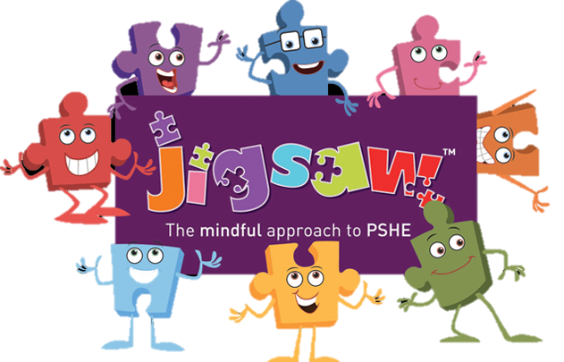
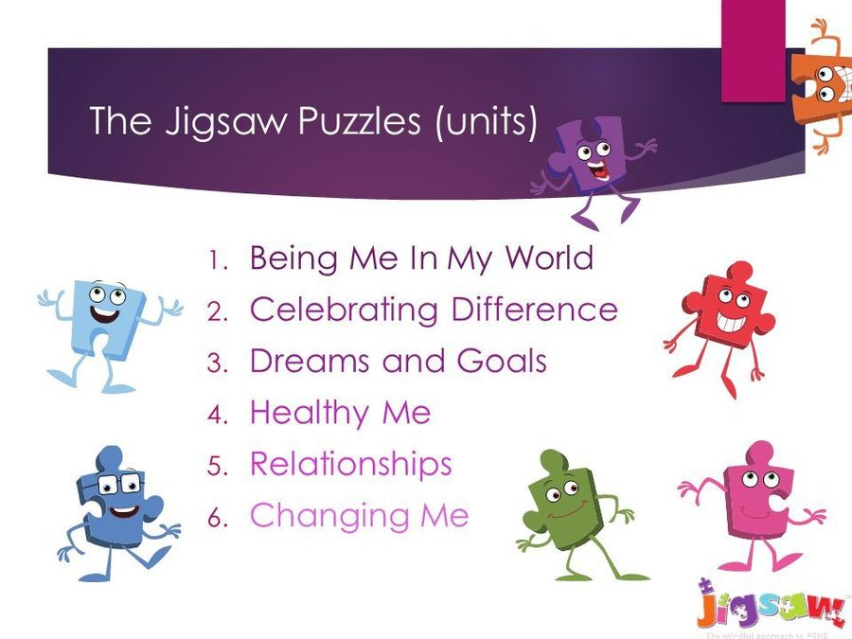
How will we be teaching RSE?
We have recently purchased ‘Jigsaw, the Mindful Approach To PSHE’. You may have heard your child talk about this at home.
The Jigsaw PSHE Programme includes lessons on ALL aspects of compulsory Relationships and Health Education, designed in a sensitive, spiral, age-appropriate curriculum. The Jigsaw teaching materials integrate Personal, Social, Health Education (PSHE), emotional literacy, social skills, mindfulness, and spiritual development in a whole-school approach. The expectations of the DfE Relationships and Health Education guidance are woven throughout Jigsaw but specifically covered in the Relationships and Healthy Me Puzzles (units), with puberty and human reproduction being taught in the Changing Me Puzzle.

Slide 9
What is included in the ‘Changing Me’ unit?
Jigsaw’s ‘Changing Me’ unit is taught over a period of 6 weeks, usually in the second half of the summer term. Each year group will be taught appropriate to their age and developmental stage, building on the previous years’ learning.
At no point will a child be taught something that is inappropriate; and if a question from a child arises and the teacher feels it would be inappropriate to answer, (for example, because of its mature or explicit nature), the child will be encouraged to ask his/her parents or carers at home. The question will not be answered to the child or class if it is outside the remit of that year group’s programme

Slide 10
The Changing Me Puzzle is all about coping positively with change and includes:
Phase 1 Growing up: how we have changed since we were babies.
Phase 1 Boys’ and girls’ bodies; correct names for body parts.
Phase 1 Boys’ and girls’ bodies; body parts and respecting privacy (which parts of the body are private and why this is).
Phase 2 How babies grow and how boys’ and girls’ bodies change as they grow older. Introduction to puberty and menstruation.
Phase 2 Internal and external reproductive body parts. Recap about puberty and menstruation. Conception explained in simple terms.
Phase 2 and 3 Puberty for boys and girls in more detail including the social and emotional aspects of becoming an adolescent. Conception explained in simple biological terms.
Phase 2 and 3 Puberty for boys and girls revisited. Understanding conception to the birth of a baby. Becoming a teenager. All lessons are taught using correct terminology, child-friendly language and diagrams.
Children will be taught in single sex age groups where appropriate

Slide 11
Can parents withdraw their child?
Parents have a right to withdraw their children from all or any part of Sex Education aspect of RSE if they wish to do so, but not from the biological aspects of human growth and reproduction provided under the National Curriculum for science.
Parents do not have to give reasons for withdrawing their child but must inform the head teacher. Requests for withdrawal should be put in writing, making it clear which aspects of the programme they do not wish their child to participate in.

Slide 12
Which lessons can parents withdraw their children from?
At The Cambridge Park academy, puberty is taught as a statutory requirement of Health Education and covered by our Jigsaw PSHE Programme in the ‘Changing Me’ Puzzle (unit). We conclude that sex education refers to Human Reproduction, and therefore parents can request their child be withdrawn from the PSHE lessons that explicitly teach this i.e. the Jigsaw Changing Me Puzzle (unit) e.g. Please check with your child’s teacher as to what is being taught.
Phase 2 Lesson 2 (Having a baby)
Phase 2 and 3 Lesson 4 (Conception)
Phase 2 and 3 Lesson 4 (Conception, birth)
Alternative work will be given to pupils who are withdrawn from non-statutory components of Sex Education.
Examples of the content of these lessons can be made available to parents if they wish.

Slide 13
Feedback
If you have any questions or feedback please contact your child’s class teacher in the first instance. Further to this please email
Mr Gardiner (Designated Safeguarding lead) or Mr Hunter (PSHE subject lead)
dgardiner@cambridgepark.het.academy
shunter@cambridgepark.het.academy

