Slide 1
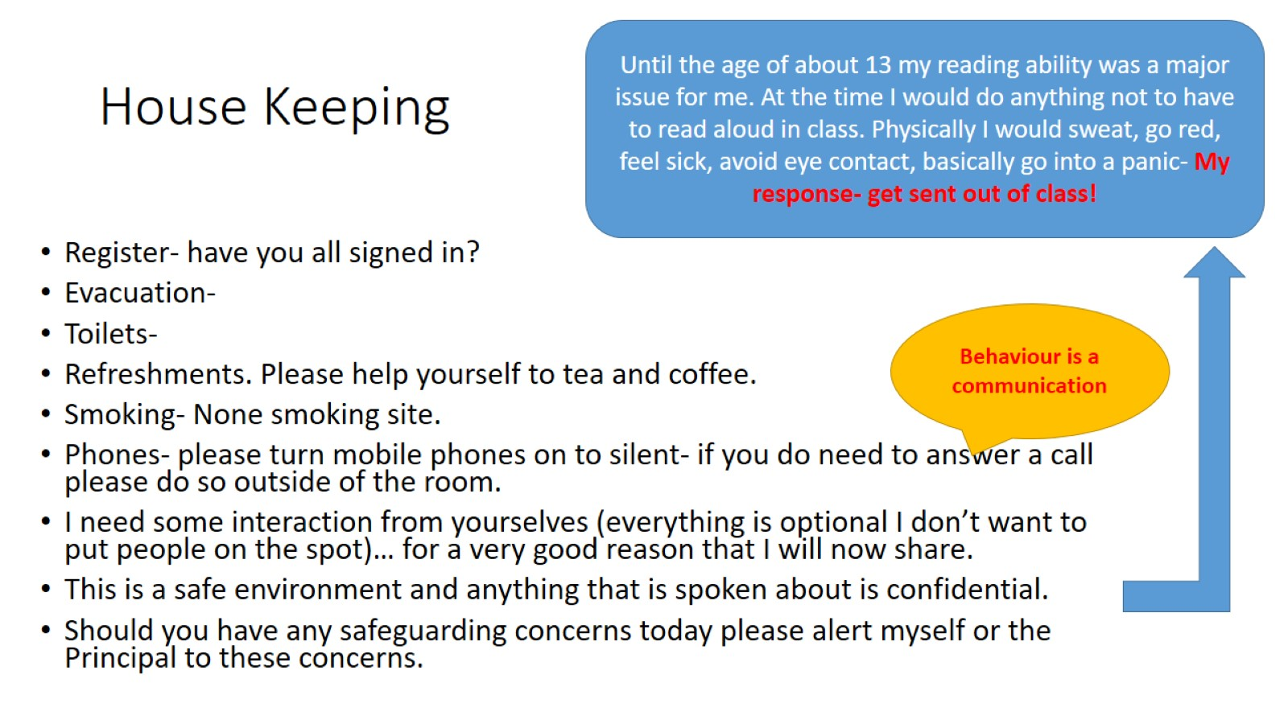
House Keeping

Slide 2
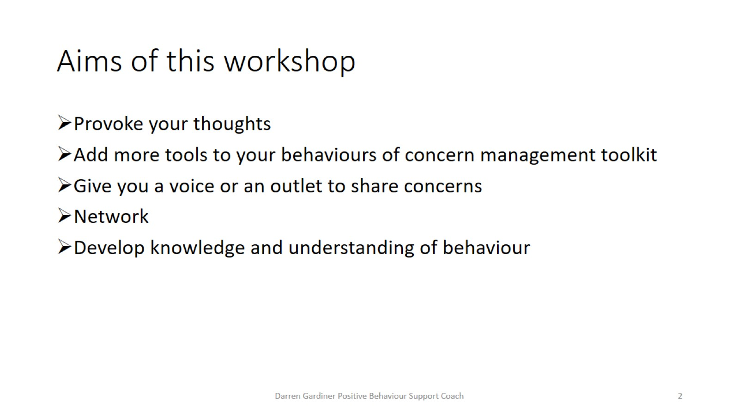
Aims of this workshop

Slide 3
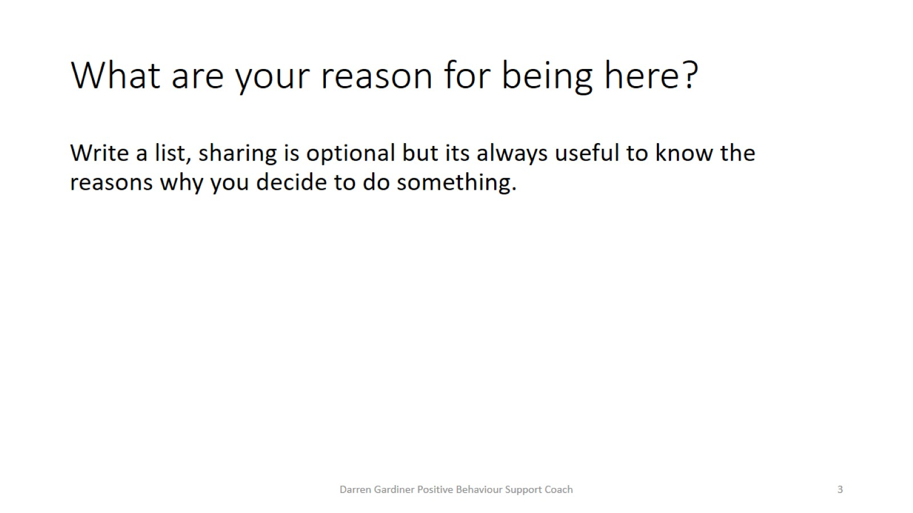
What are your reason for being here?

Slide 4
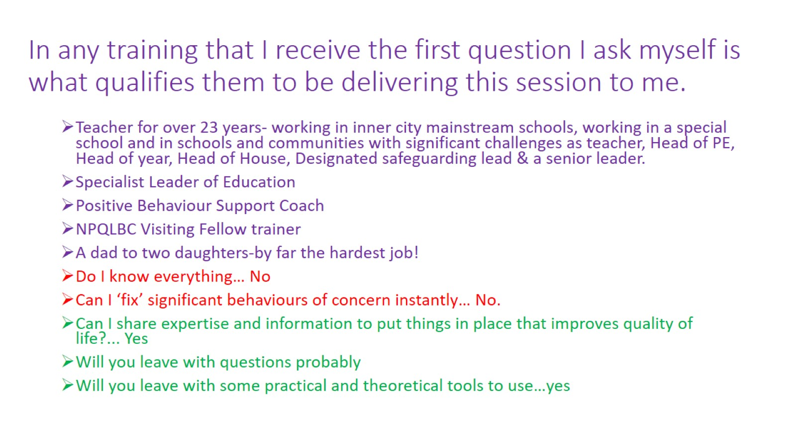
In any training that I receive the first question I ask myself is what qualifies them to be delivering this session to me.

Slide 5
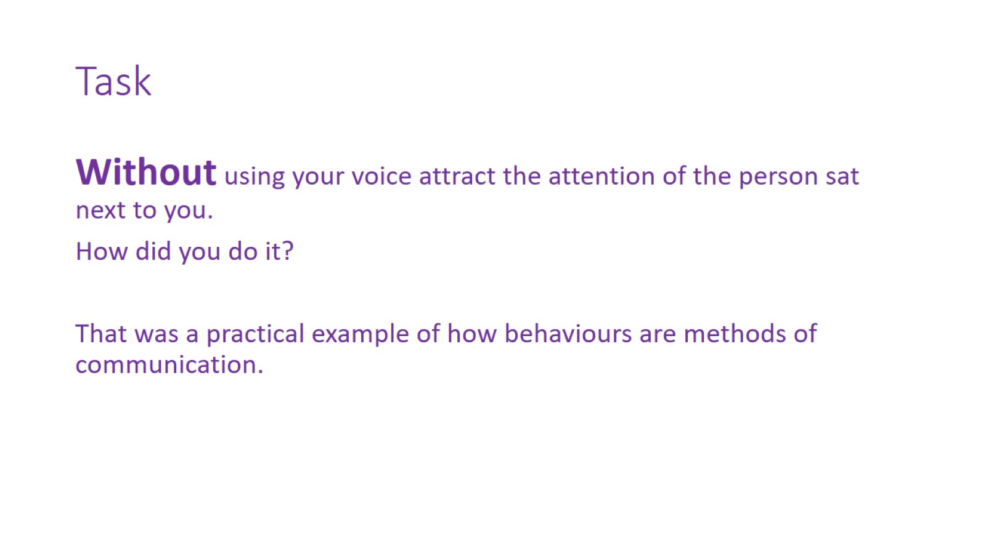
Task

Slide 6
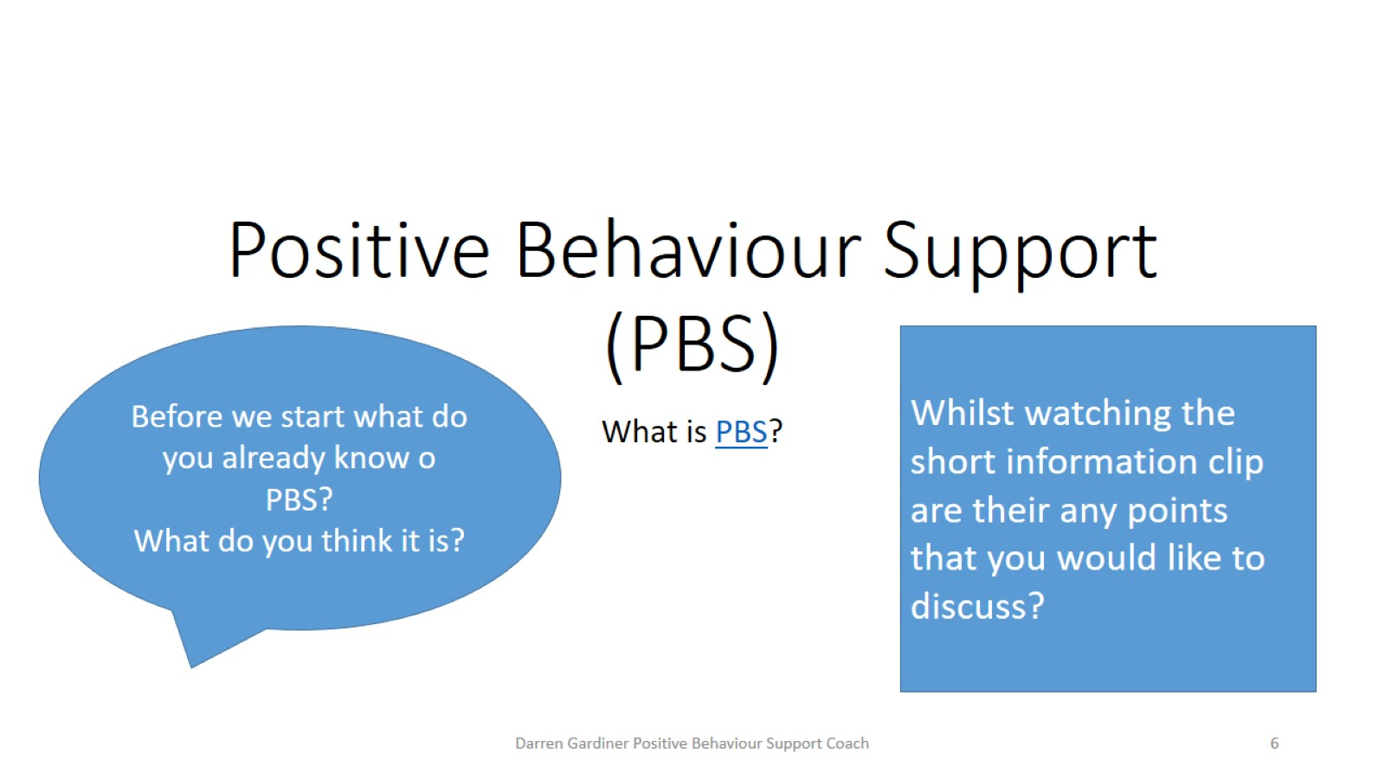
Positive Behaviour Support (PBS)

Slide 7
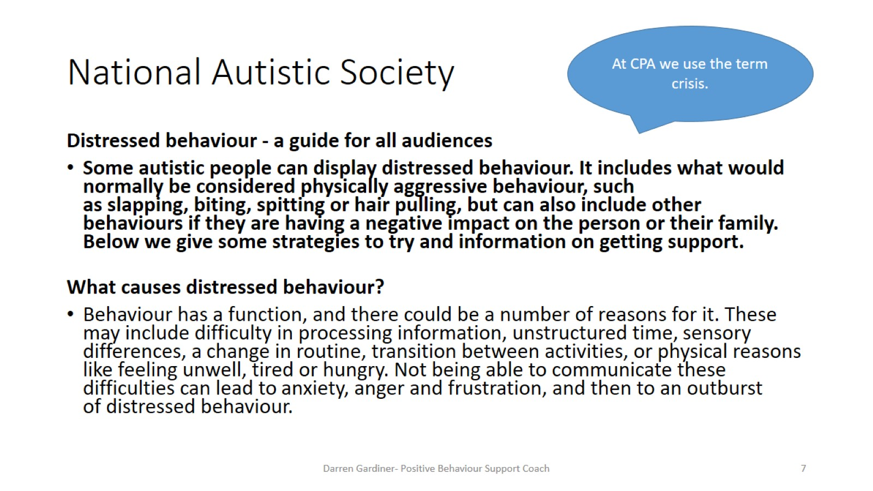
National Autistic Society

Slide 8
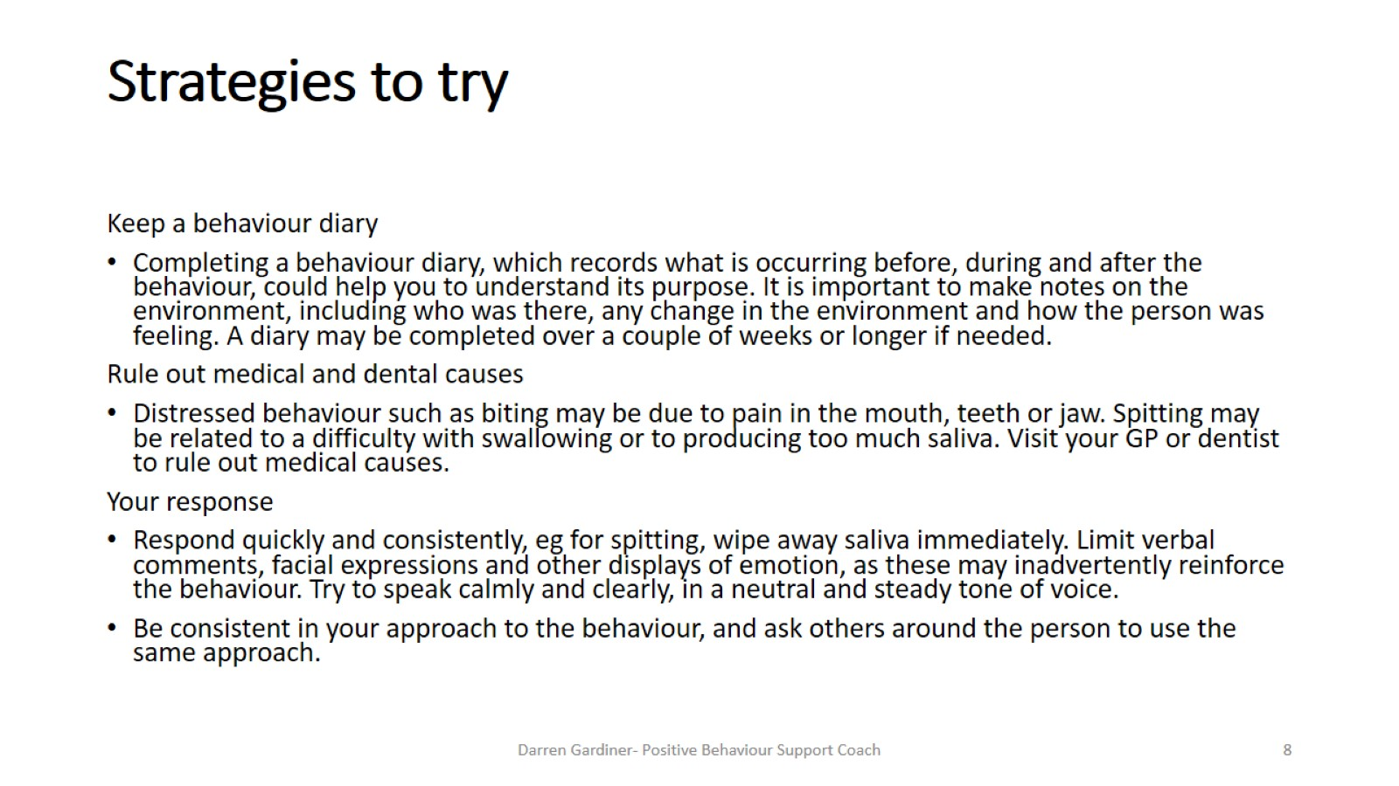
Strategies to try

Slide 9
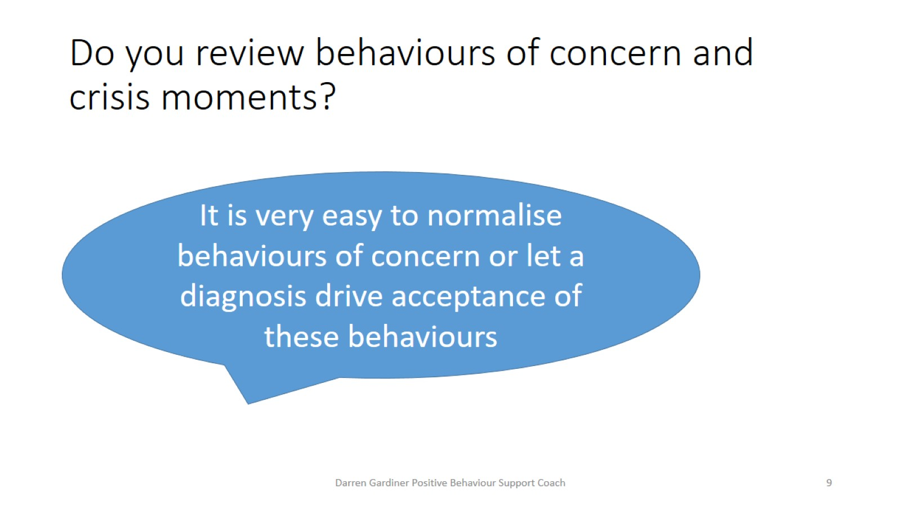
Do you review behaviours of concern and crisis moments?

Slide 10
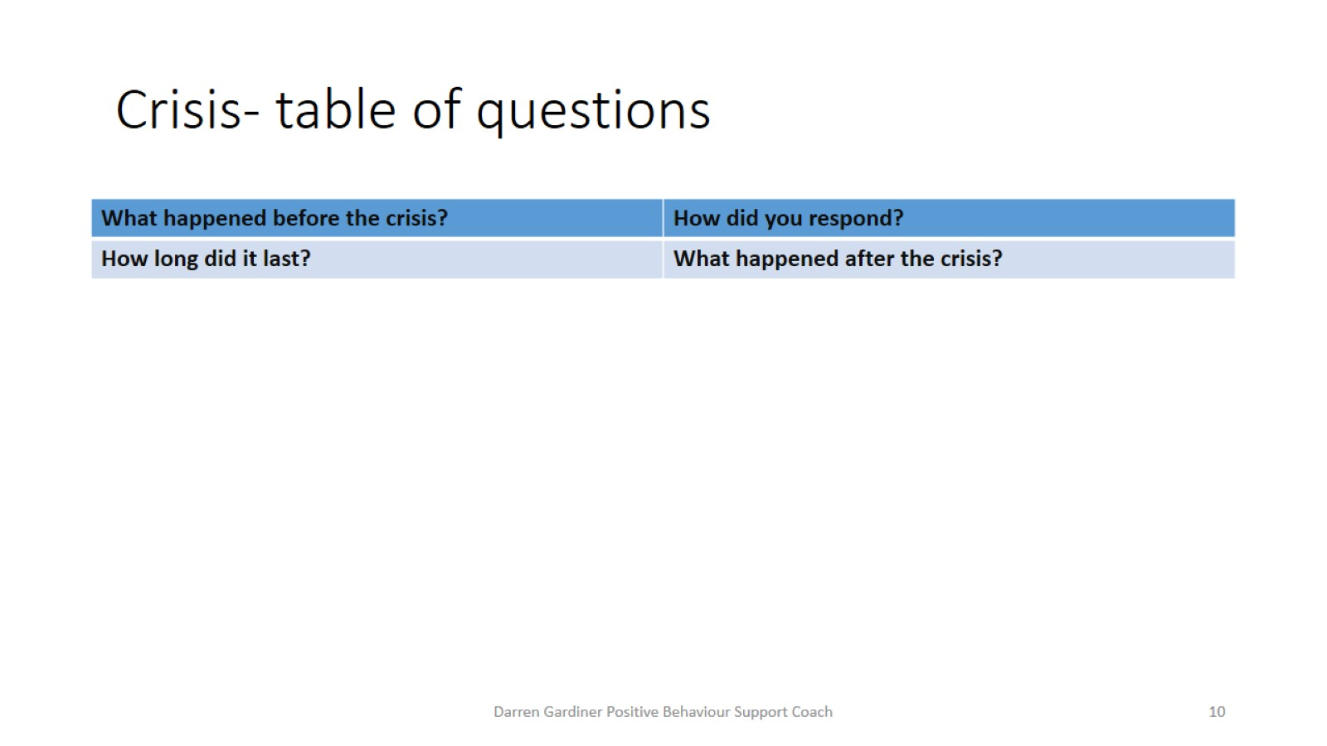
Crisis- table of questions

Slide 11
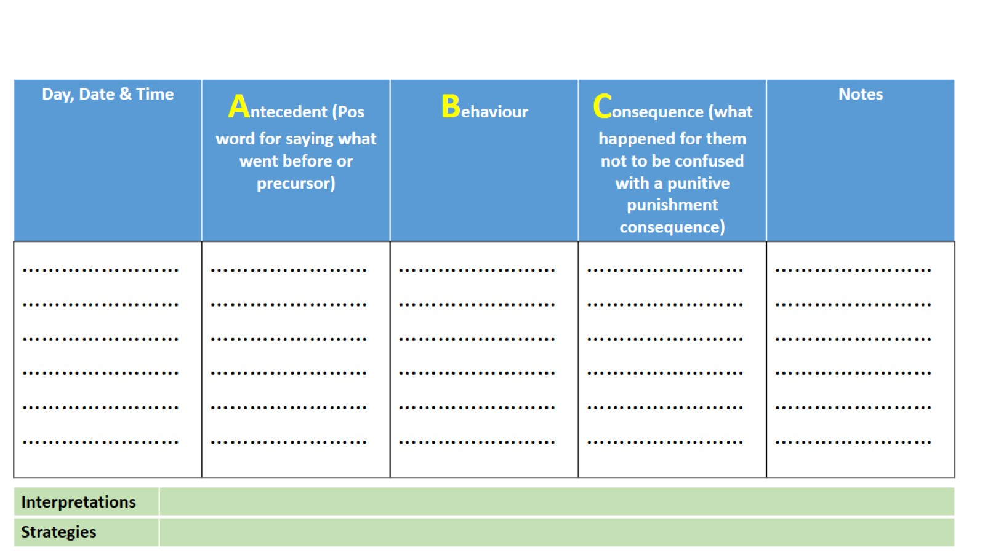
For your own child complete an ABC table for a behaviour of concern that is most prevalent for them at home.

Slide 12
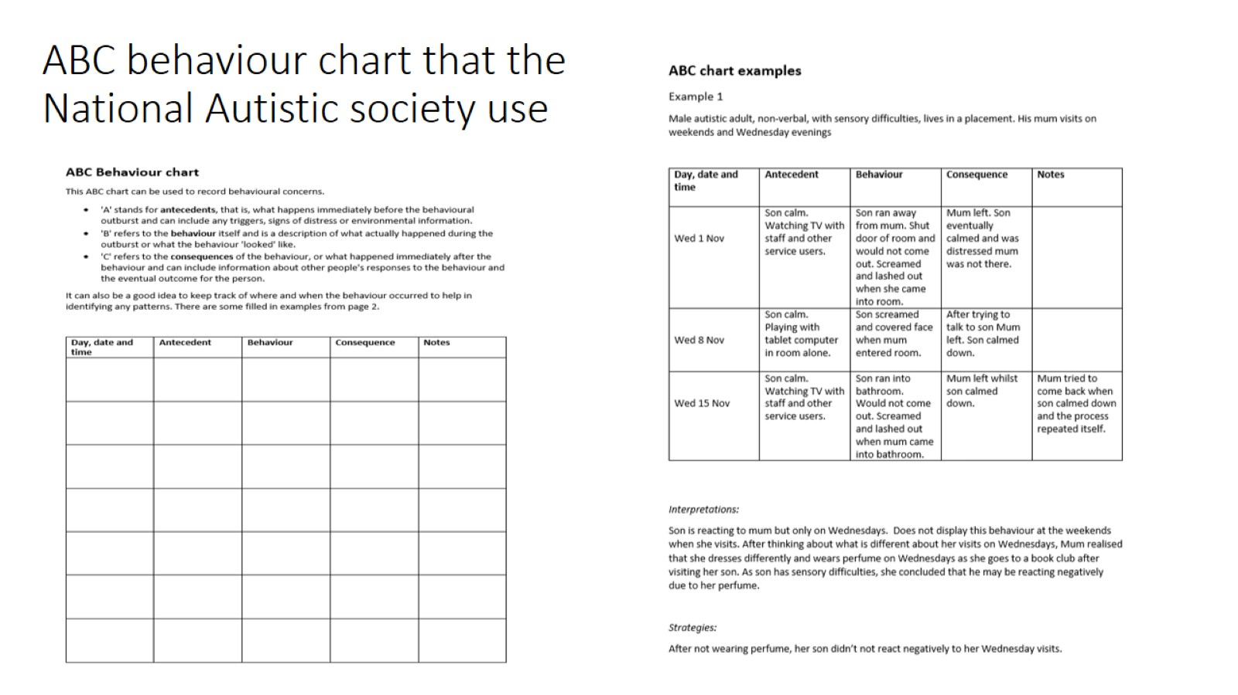
ABC behaviour chart that the National Autistic society use

Slide 13
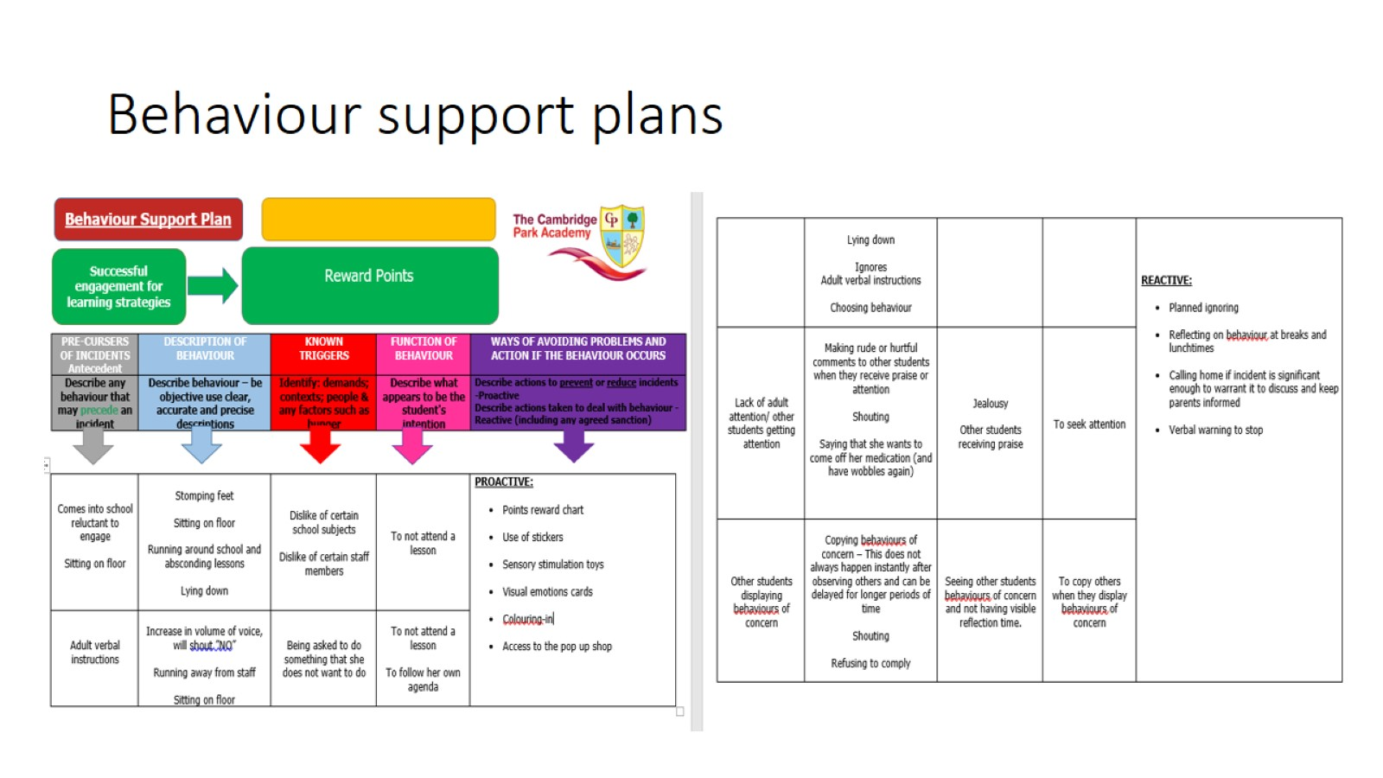
Behaviour support plans

Slide 14
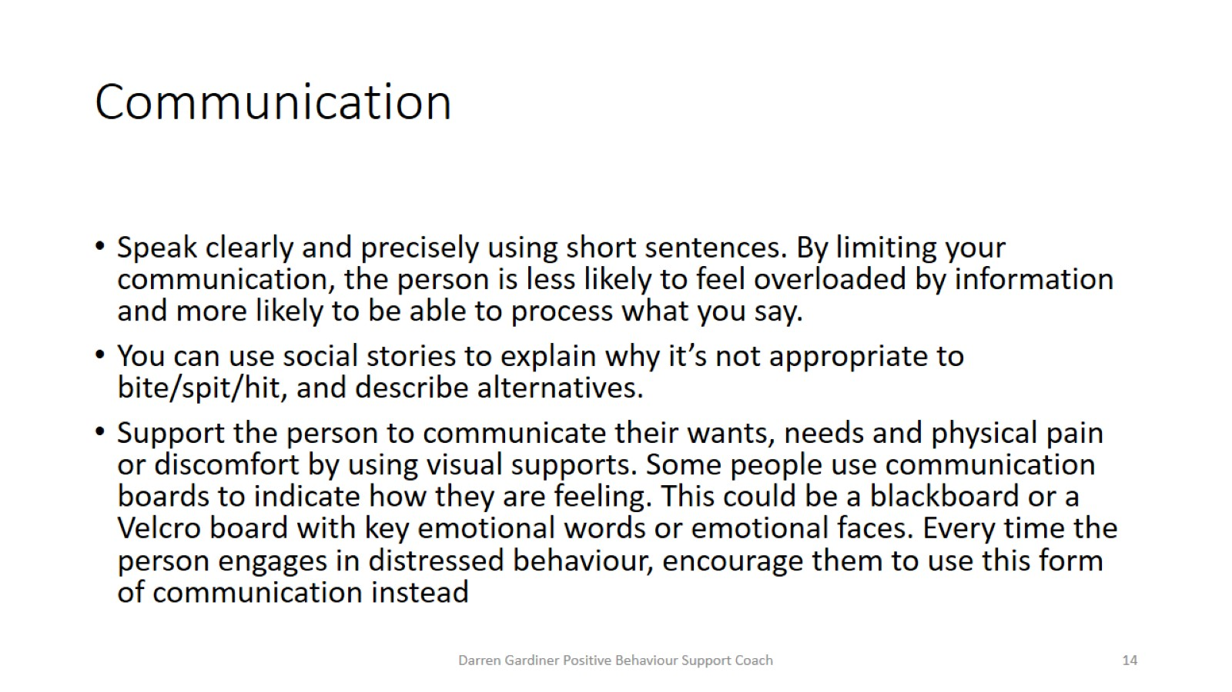
Communication

Slide 15
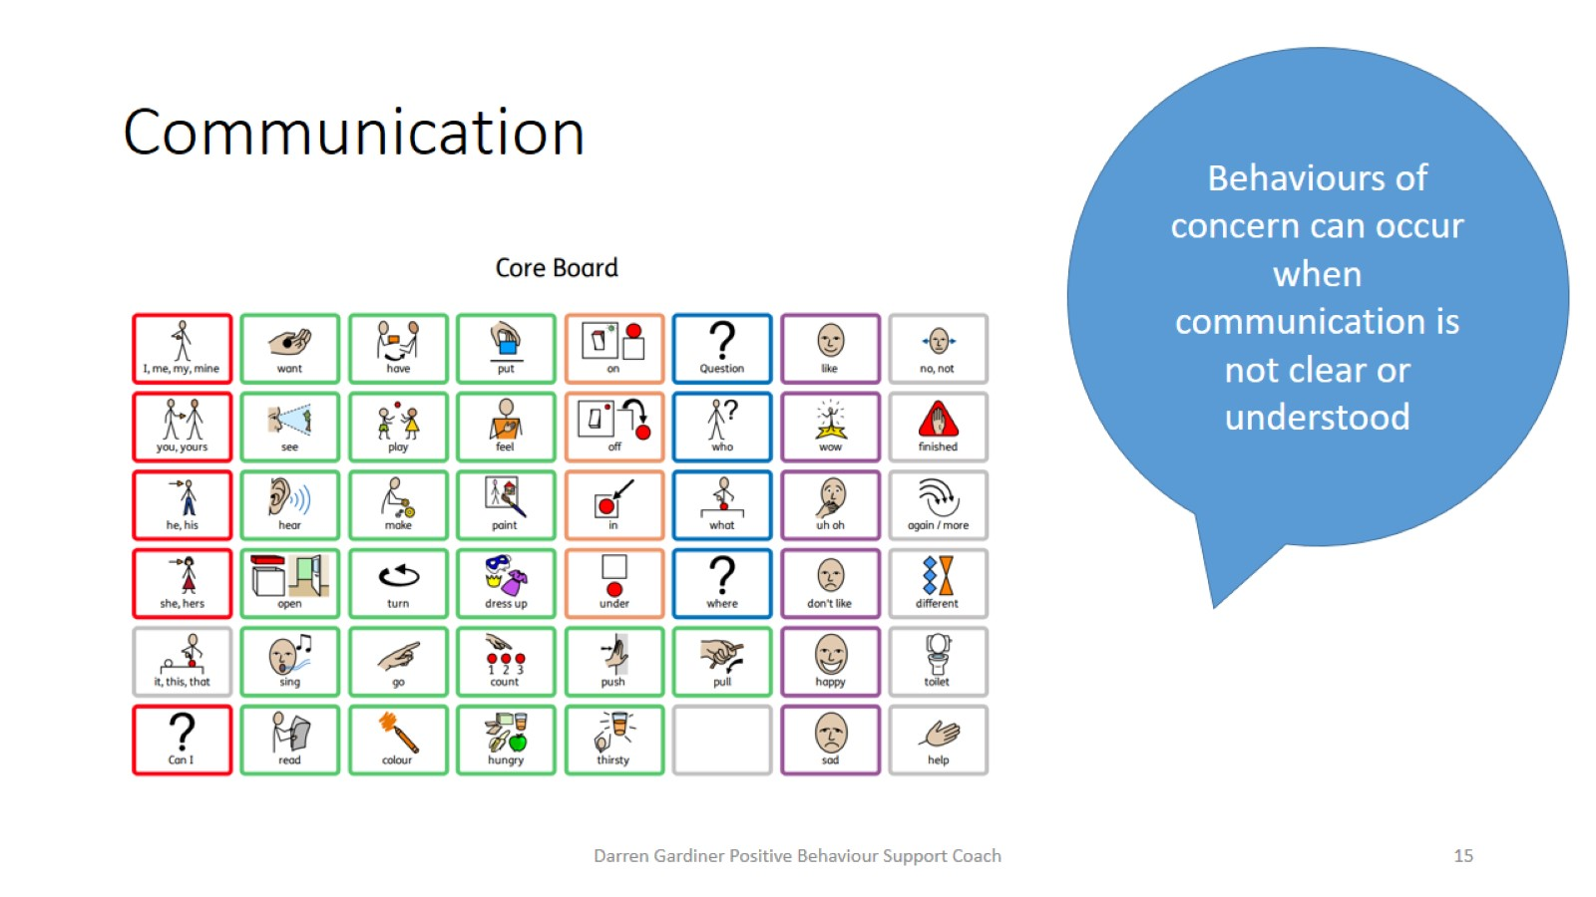
Communication

Slide 16
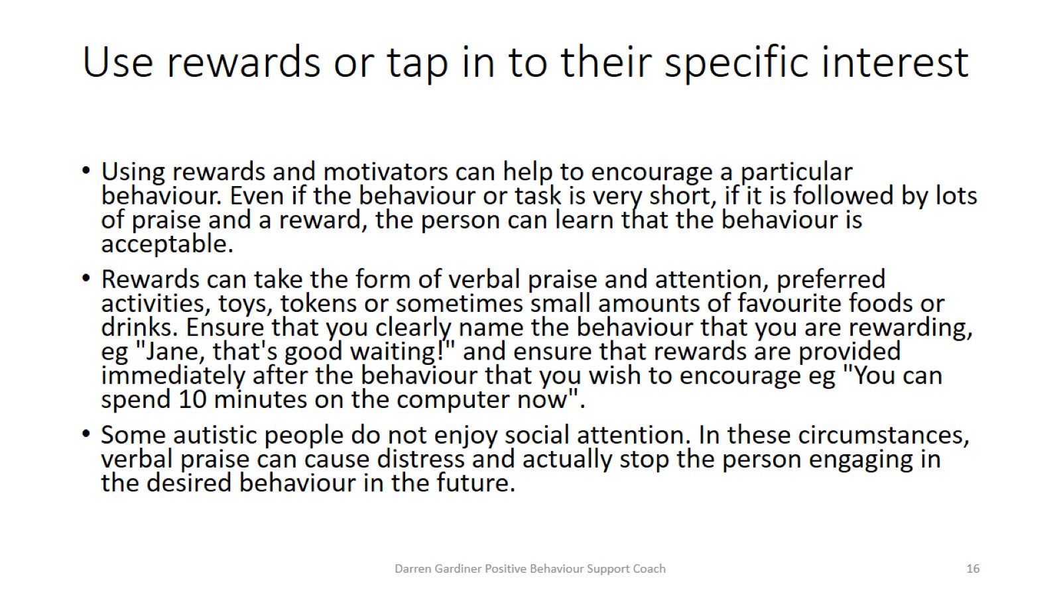
Use rewards or tap in to their specific interest

Slide 17
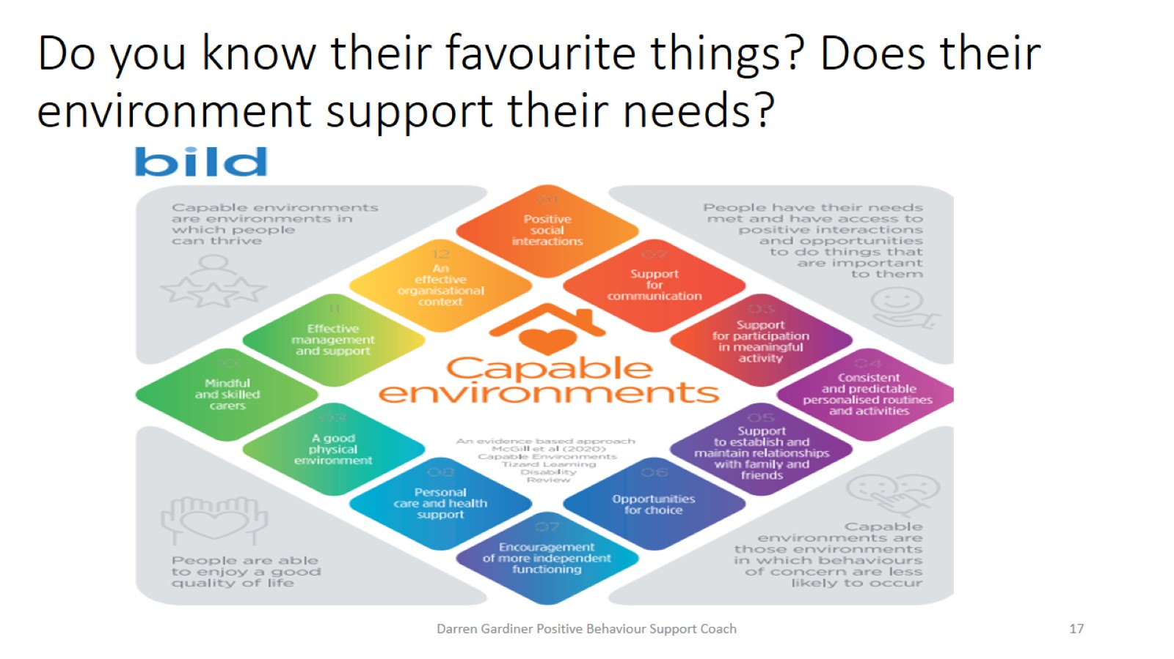
Do you know their favourite things? Does their environment support their needs?

Slide 18
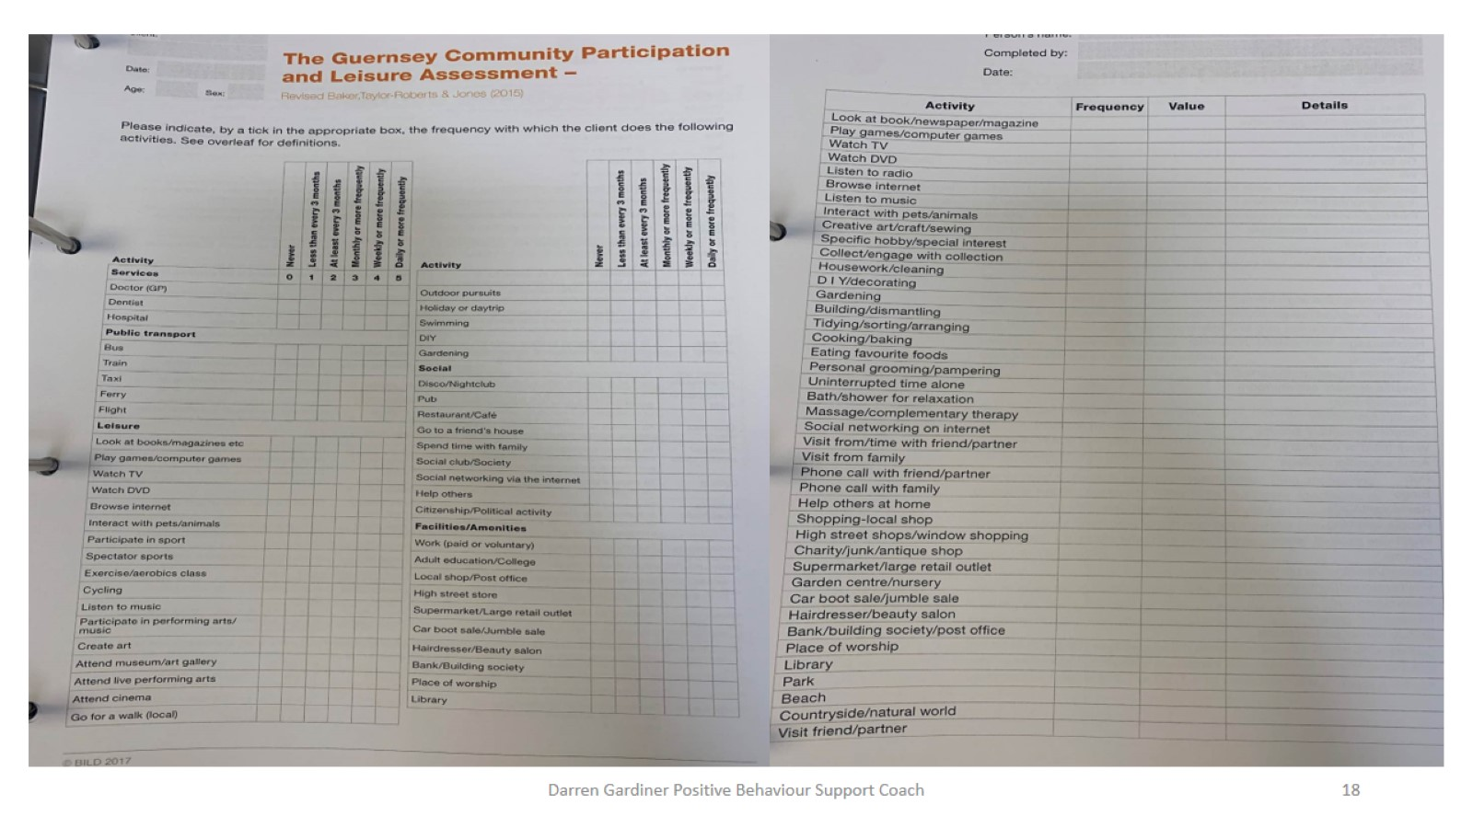

Slide 19
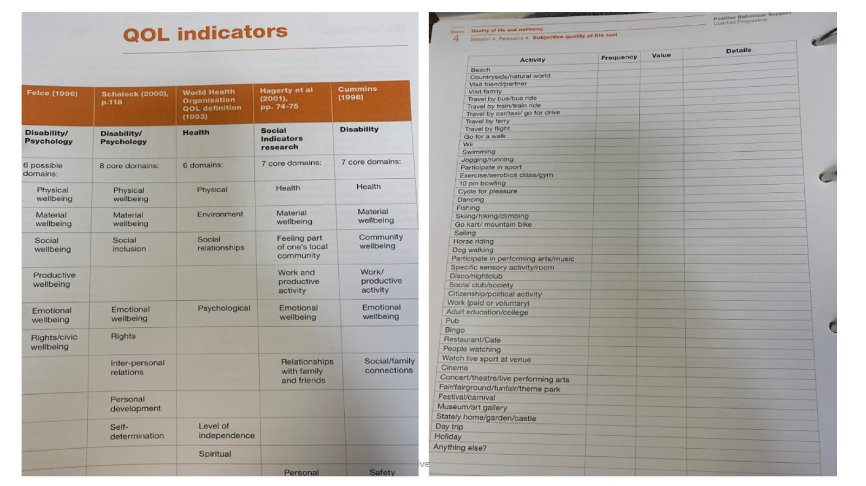

Slide 20
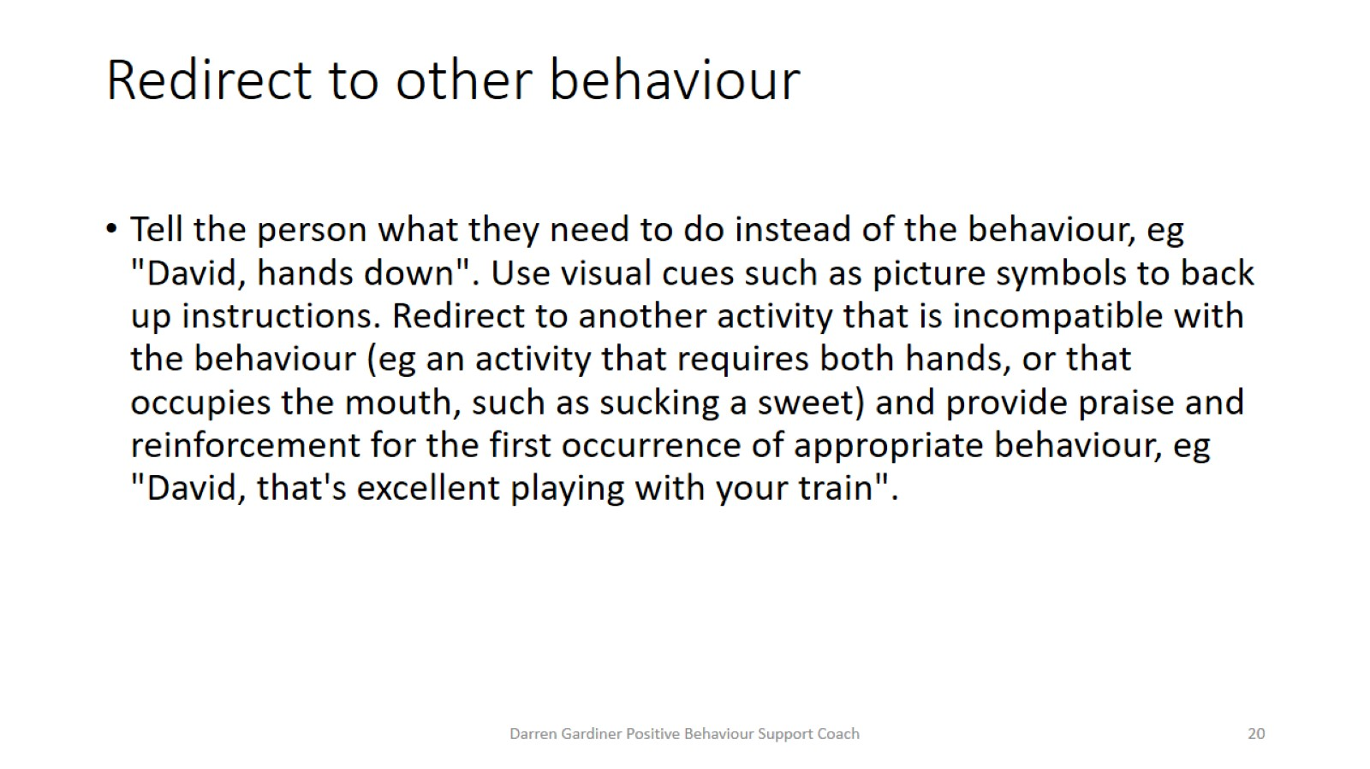
Redirect to other behaviour

Slide 21
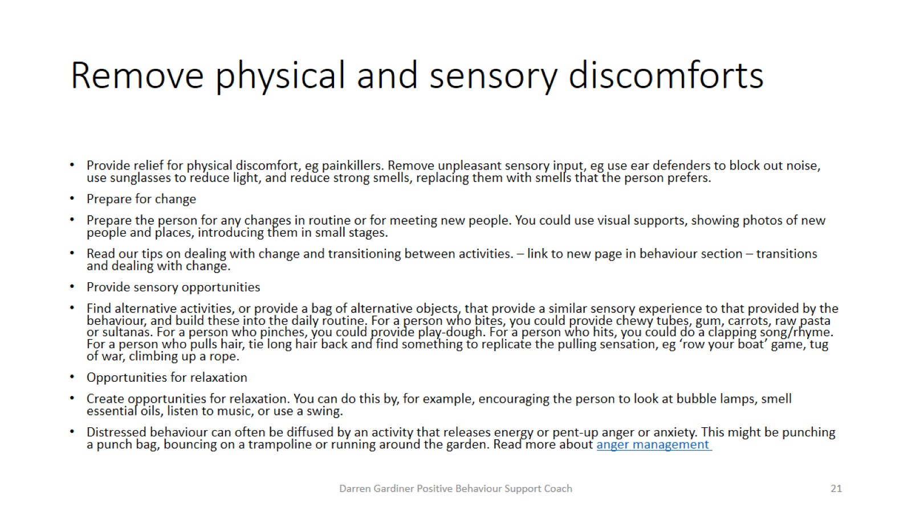
Remove physical and sensory discomforts

Slide 22
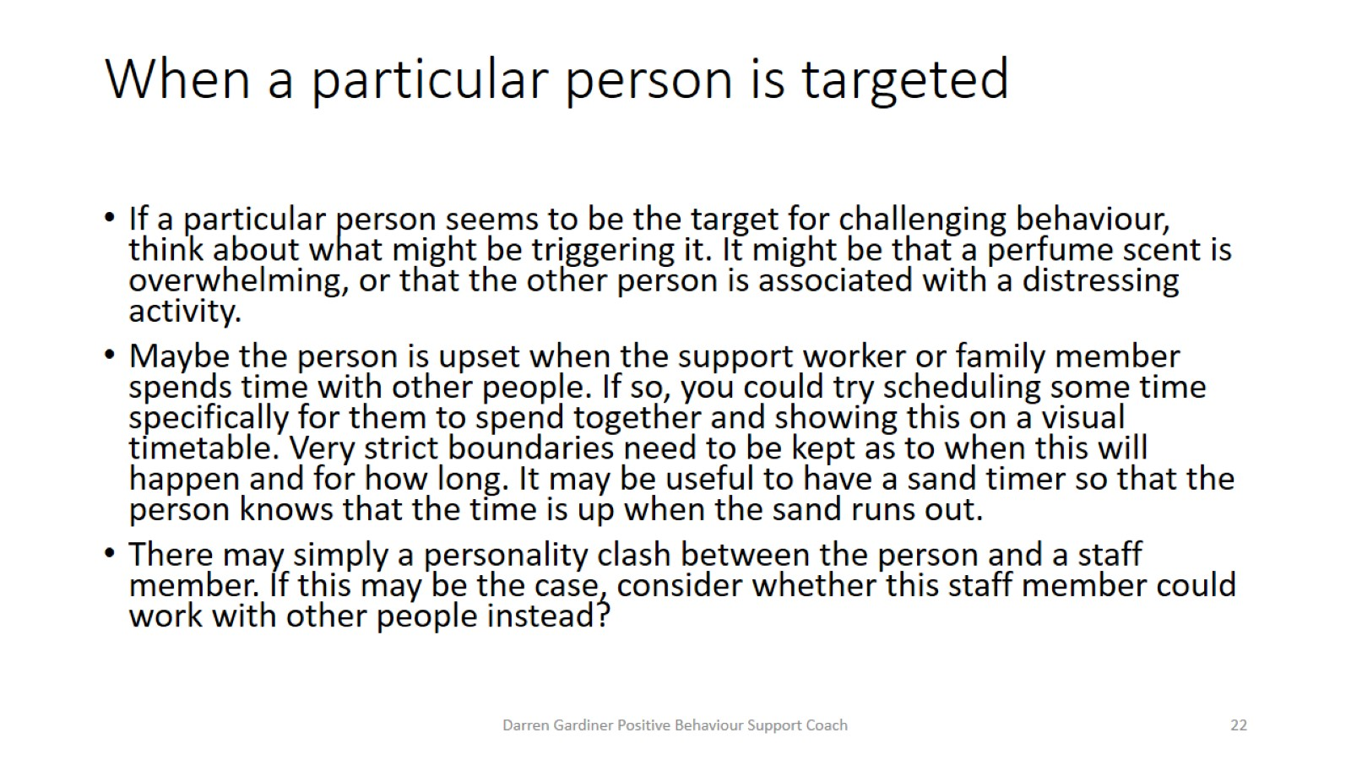
When a particular person is targeted

Slide 23
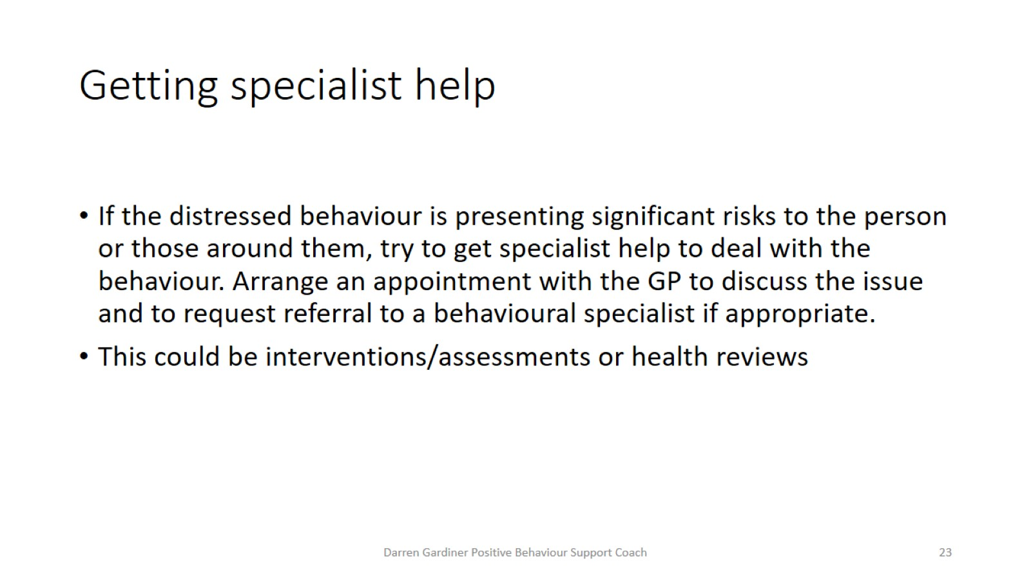
Getting specialist help

Slide 24
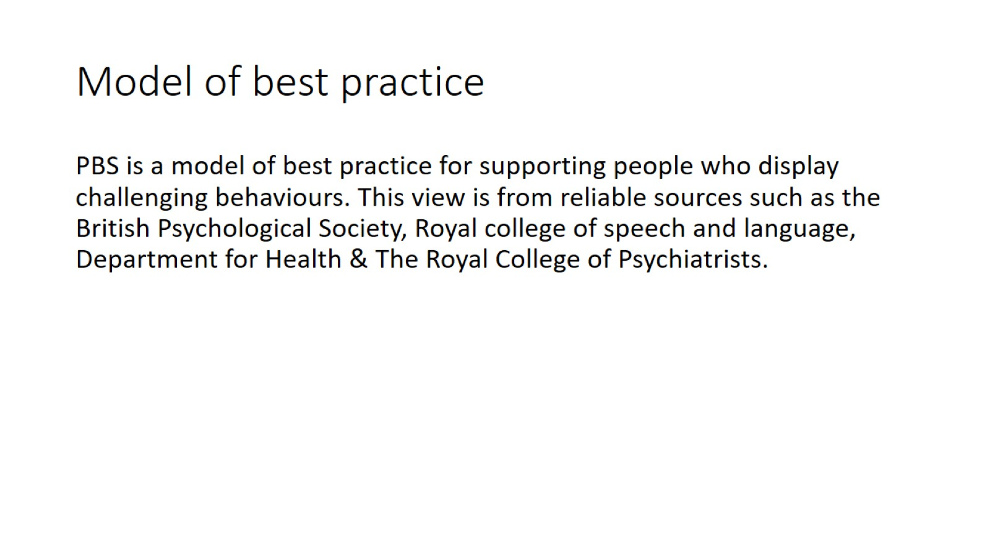
Model of best practice

Slide 25
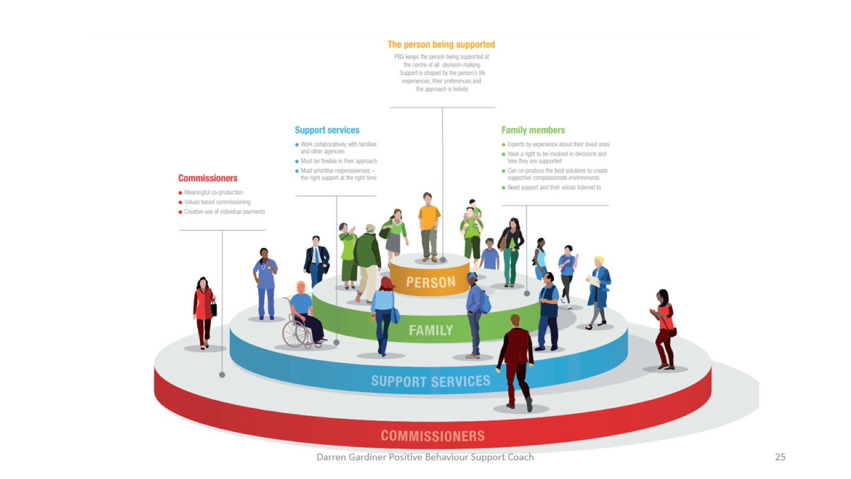

Slide 26
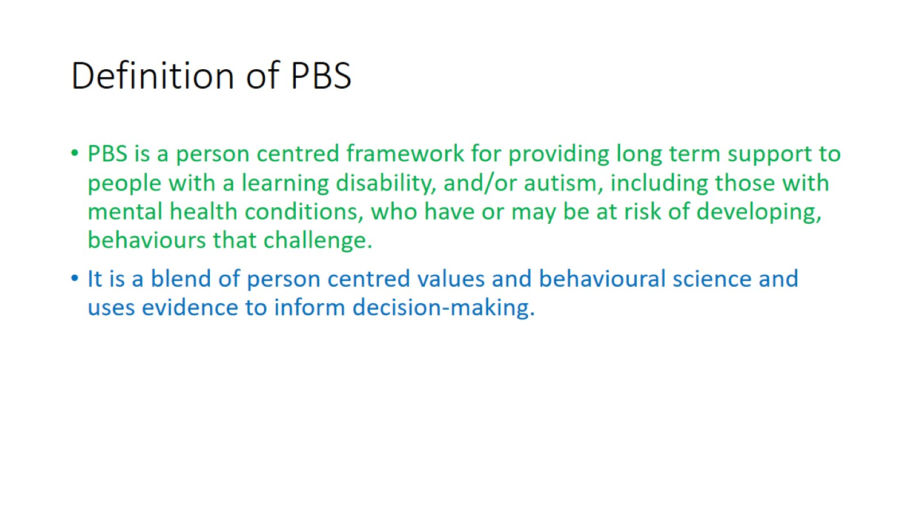
Definition of PBS

Slide 27
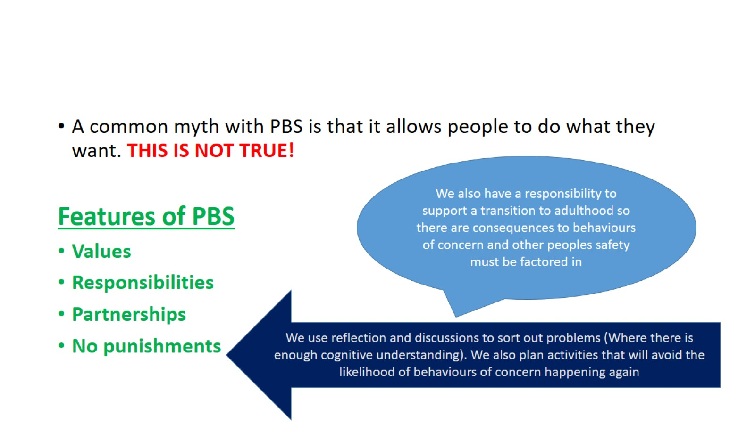

Slide 28
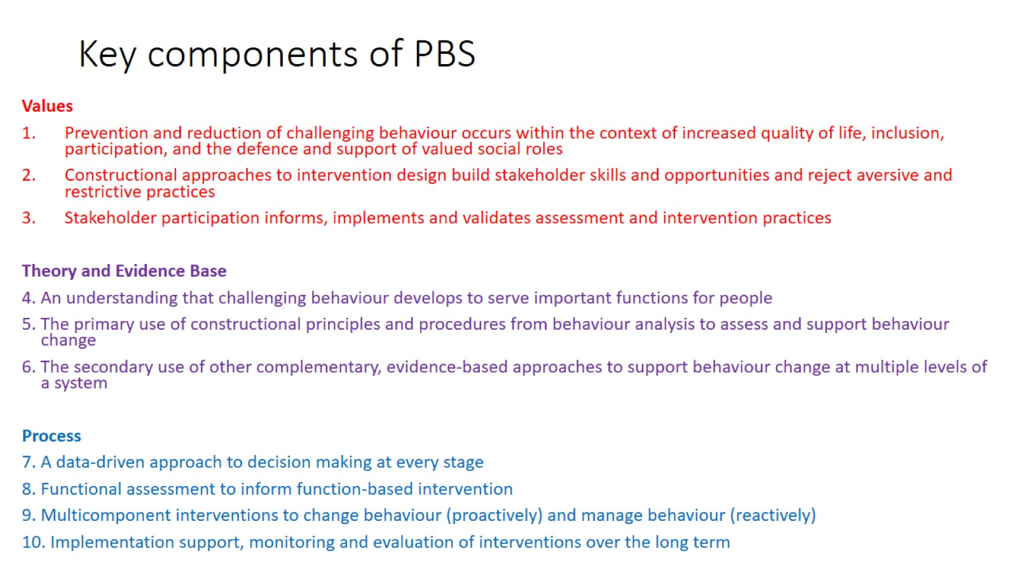
Key components of PBS

Slide 29
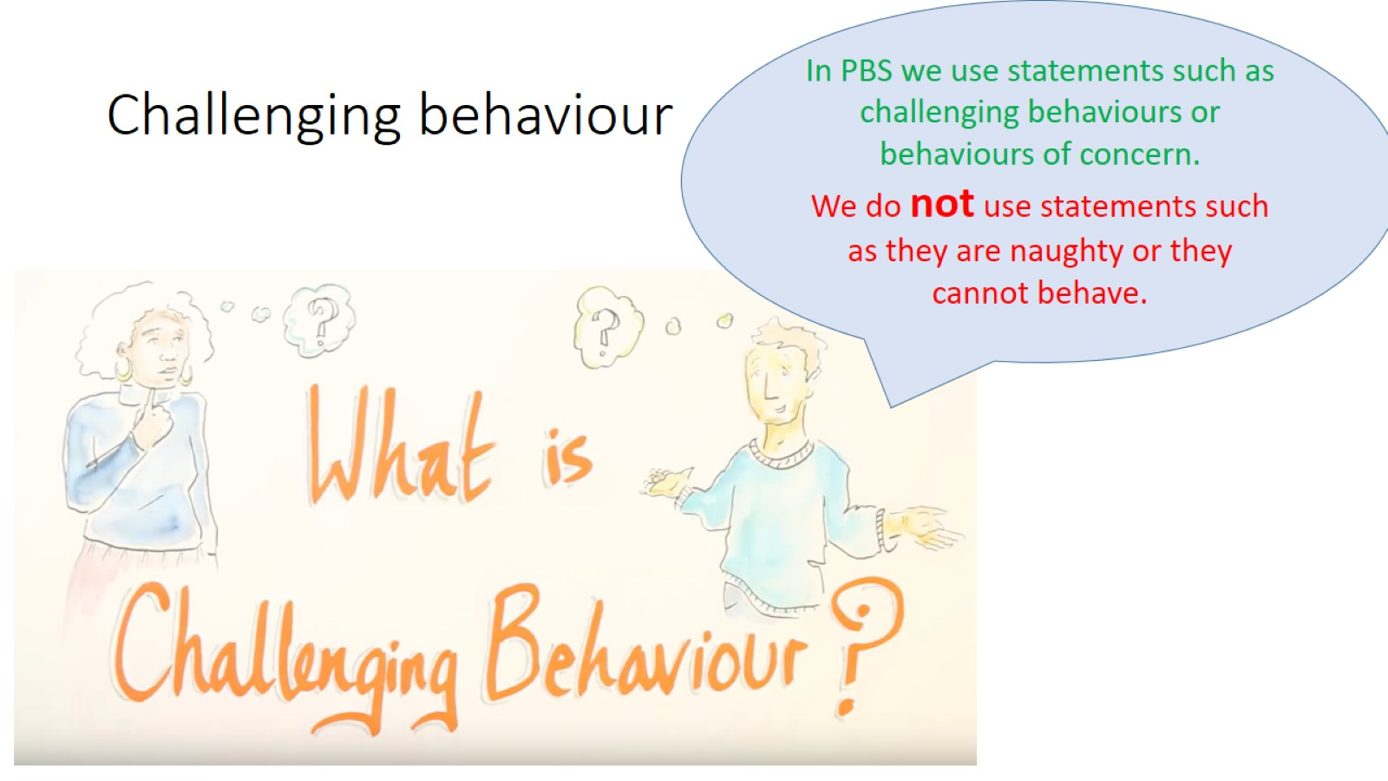
Challenging behaviour

Slide 30
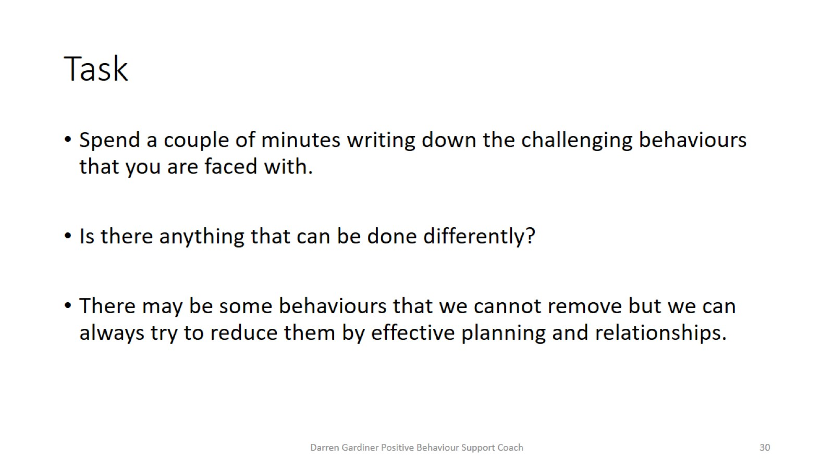
Task

Slide 31
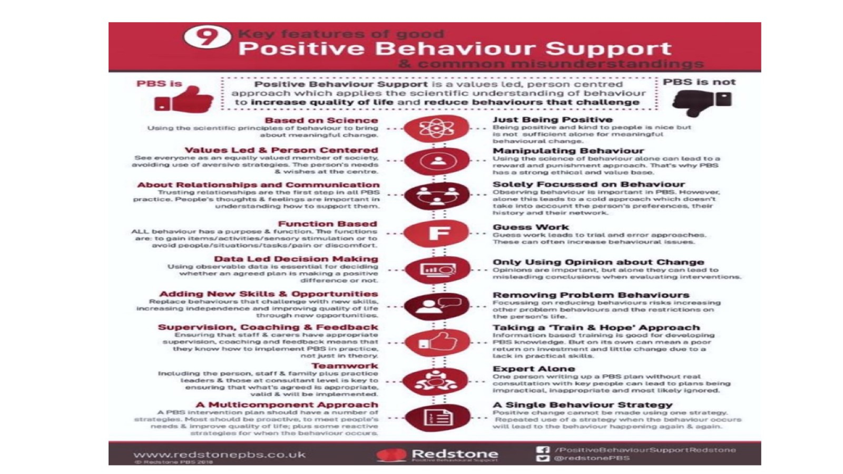

Slide 32
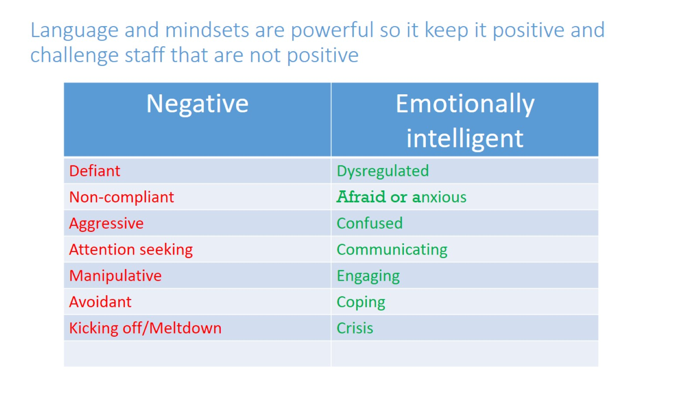
Language and mindsets are powerful so it keep it positive and challenge staff that are not positive

Slide 33
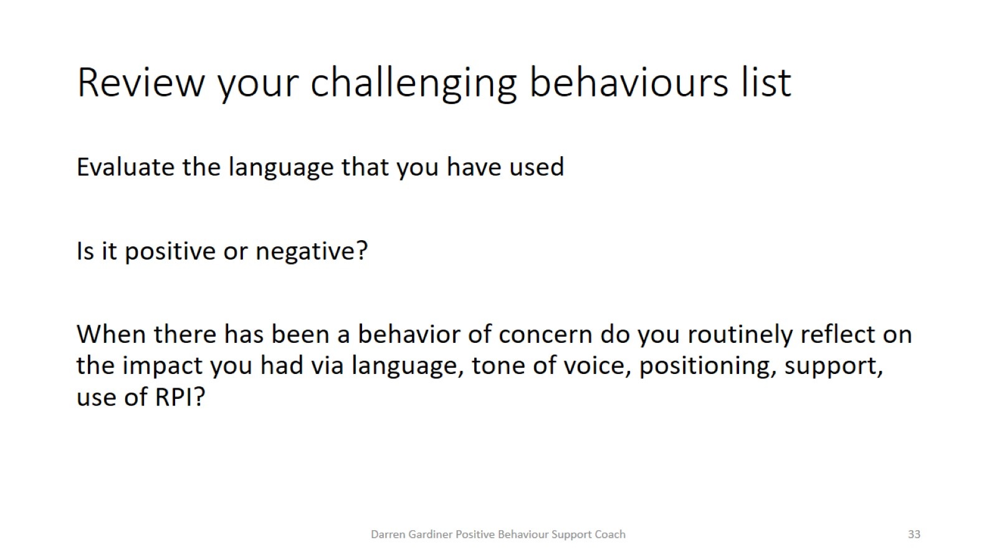
Review your challenging behaviours list

Slide 34
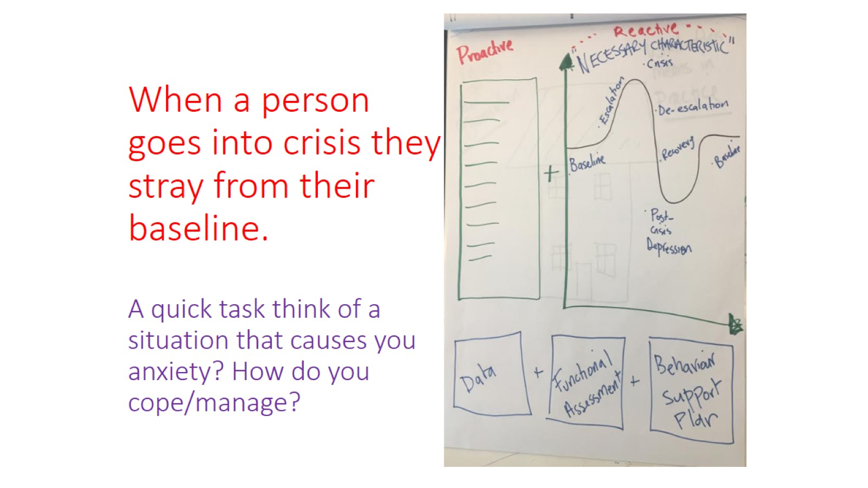
When a person goes into crisis they stray from their baseline.
A quick task think of a situation that causes you anxiety? How do you cope/manage?

Slide 35
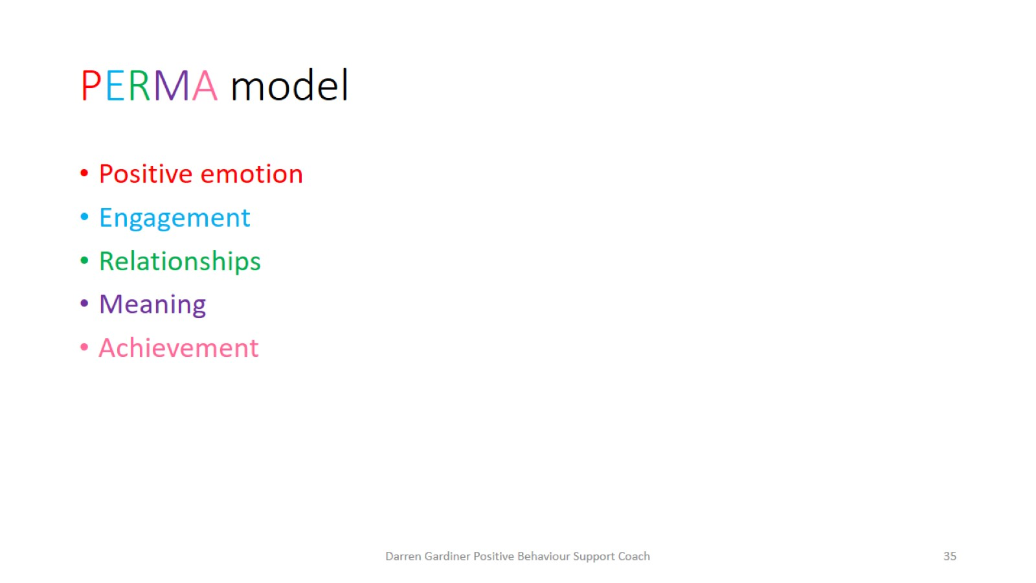
PERMA model

Slide 36
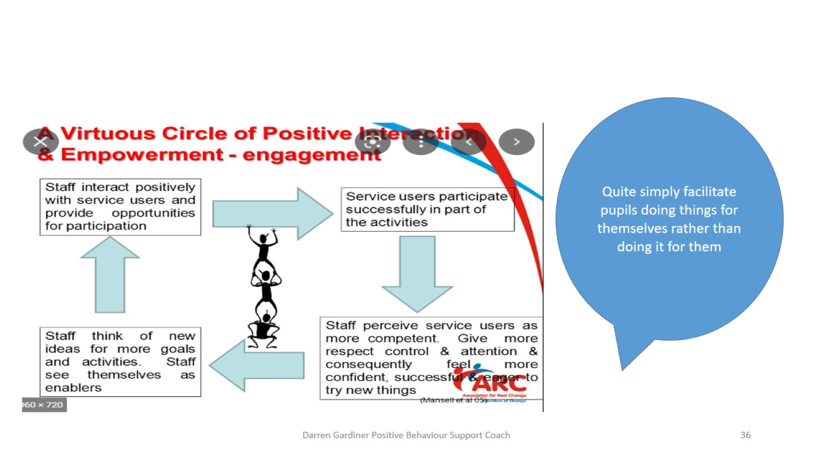

Slide 37
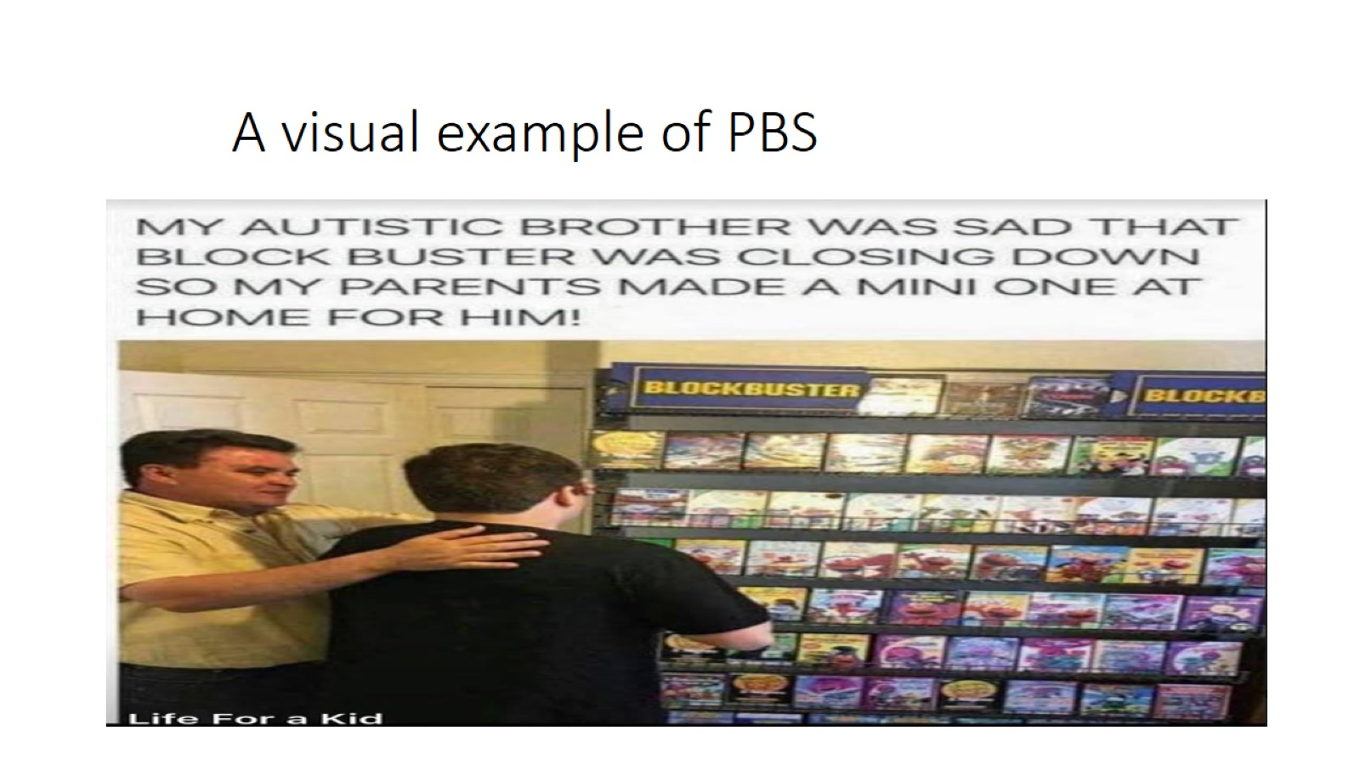
A visual example of PBS

Slide 38
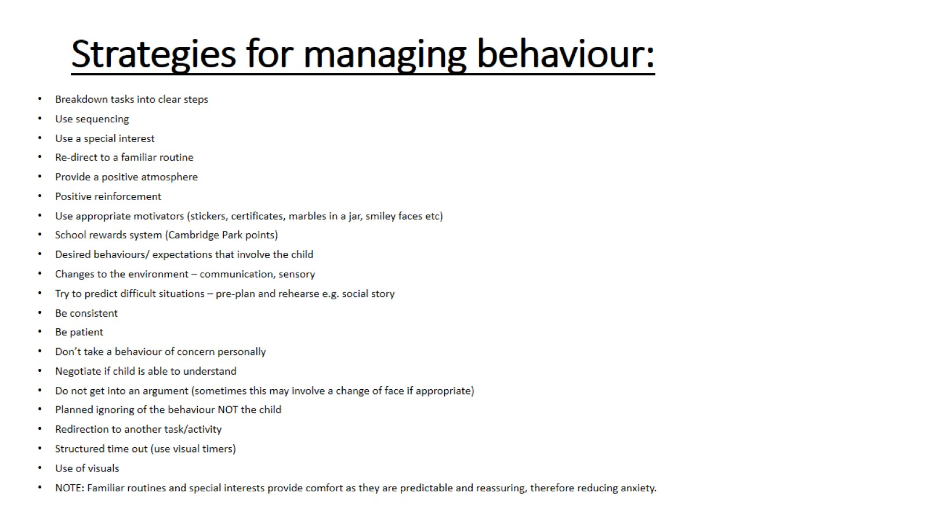
Strategies for managing behaviour:

Slide 39
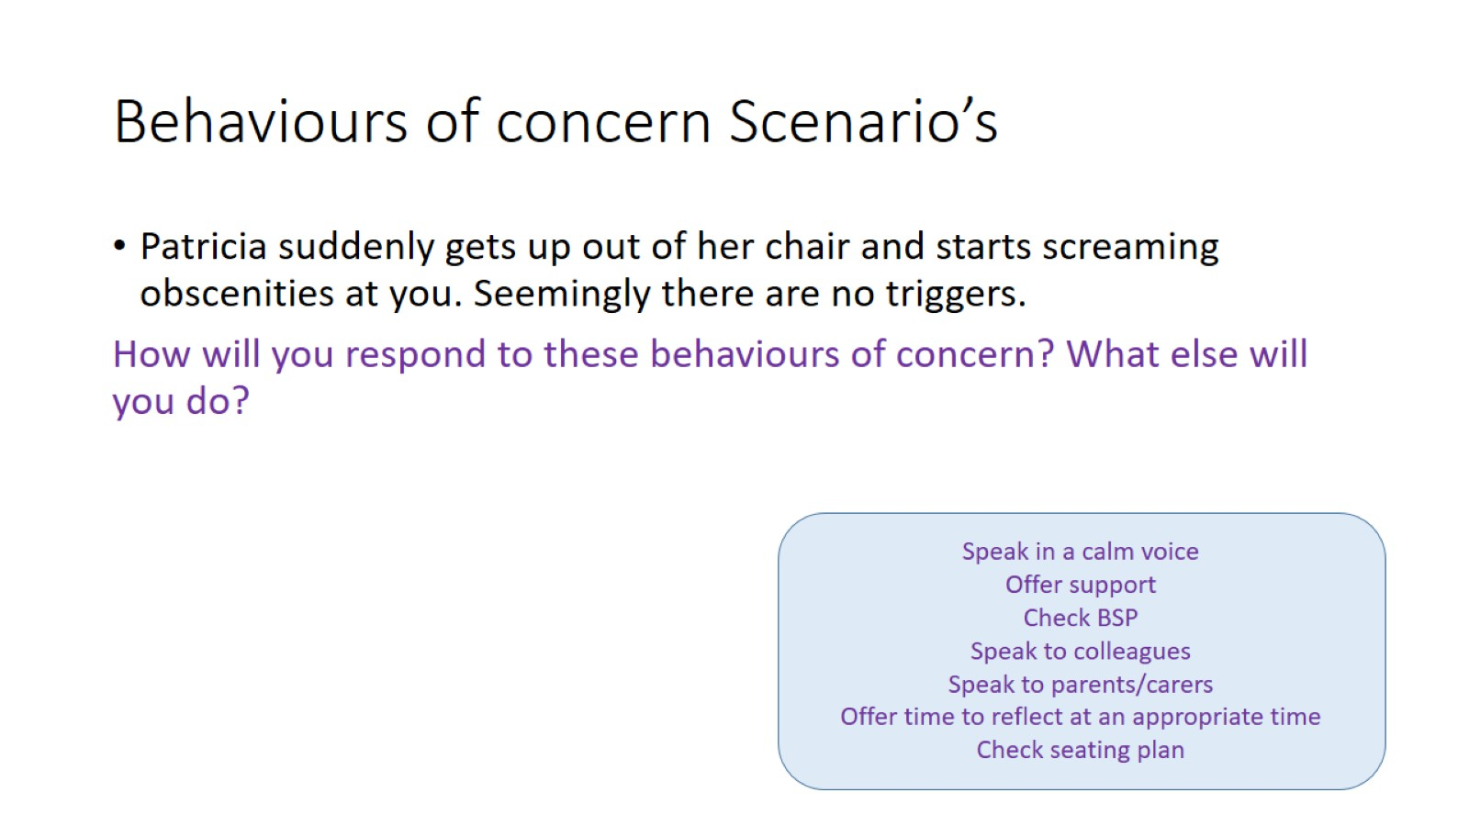
Behaviours of concern Scenario’s

Slide 40
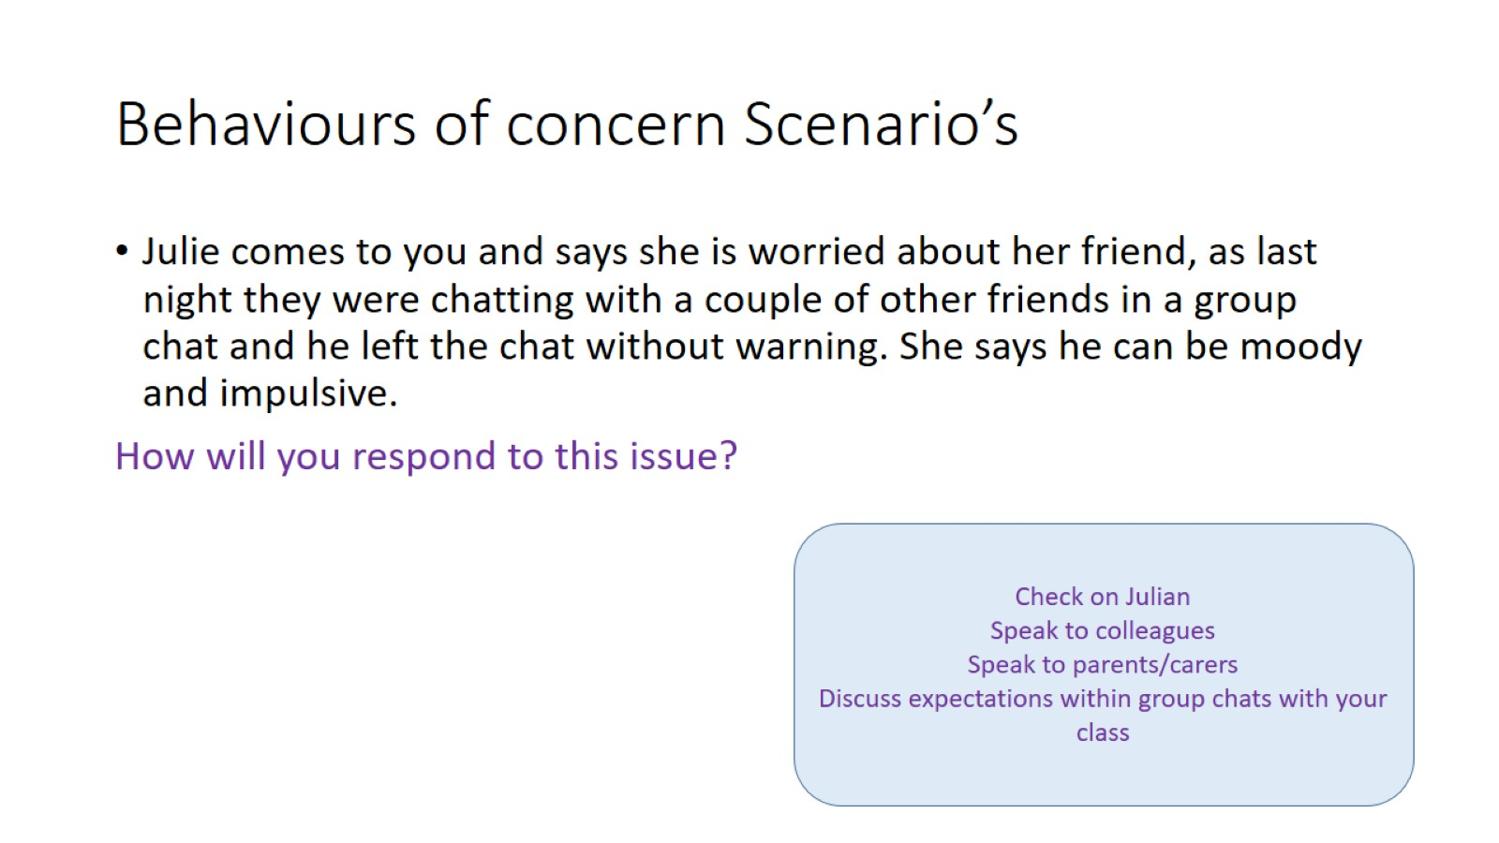
Behaviours of concern Scenario’s

Slide 41
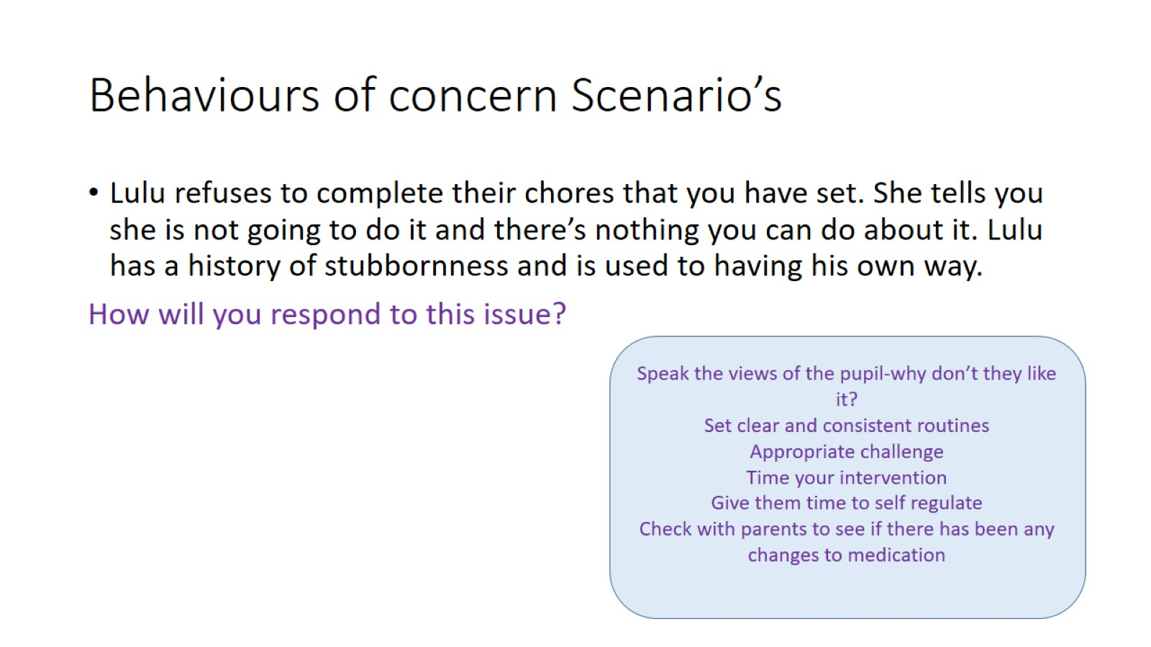
Behaviours of concern Scenario’s

Slide 42
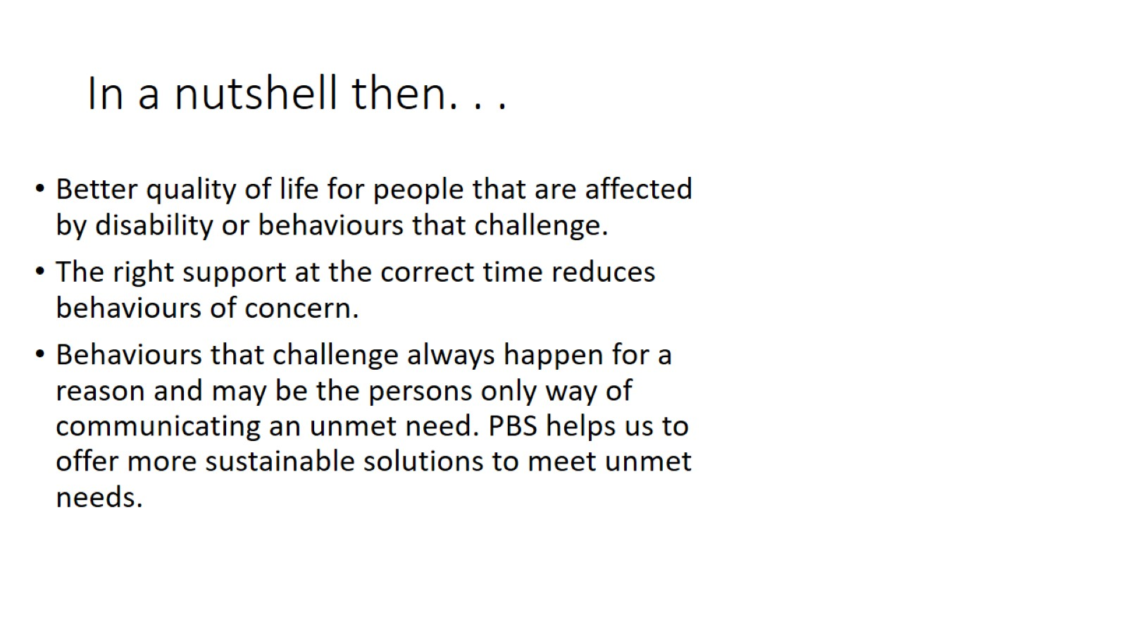
In a nutshell then. . .

Slide 43
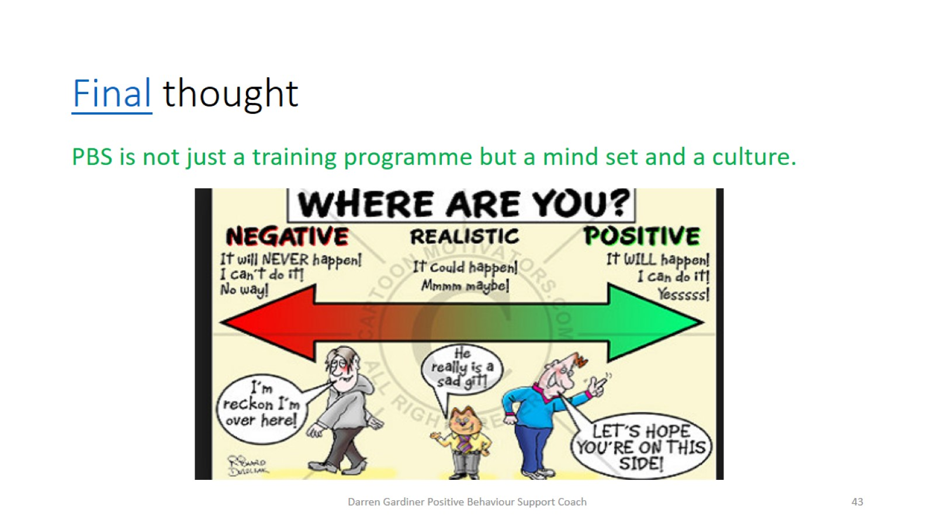
Final thought

Slide 44
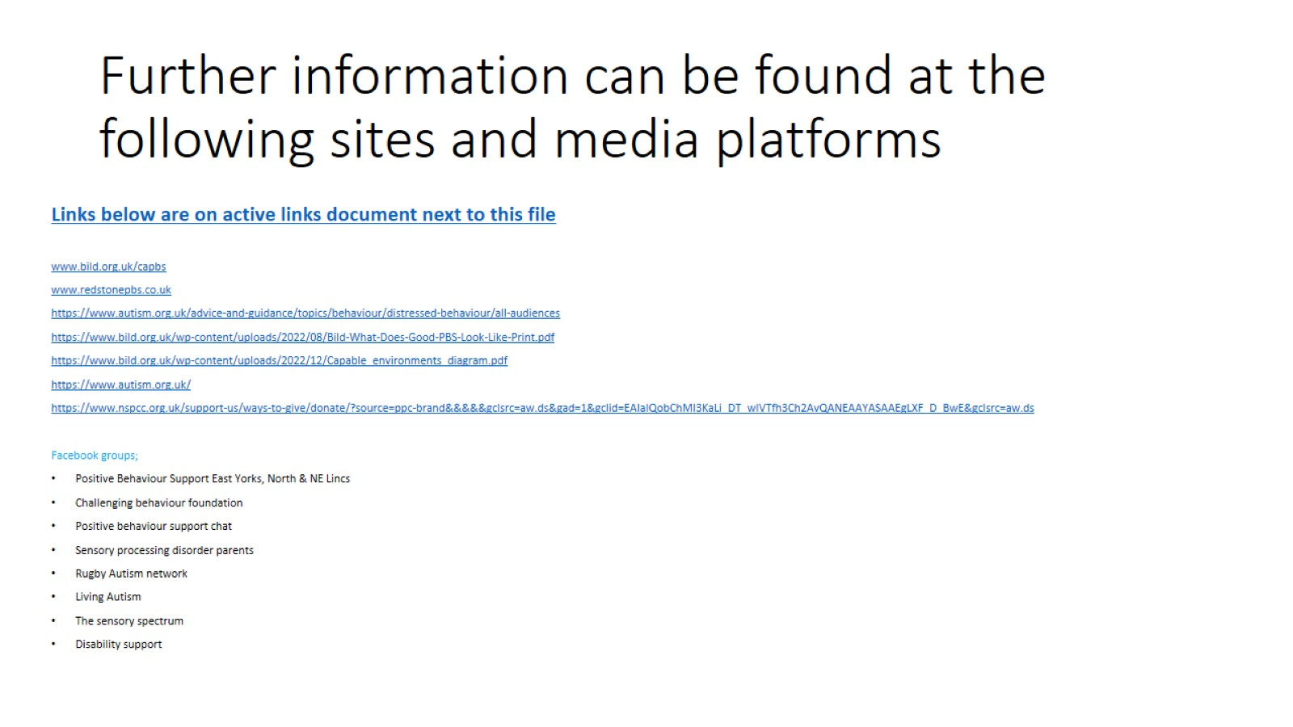
Further information can be found at the following sites and media platforms

